Slide 1

Black River-Matheson
Municipal Operations
Who Does What?

Slide 2
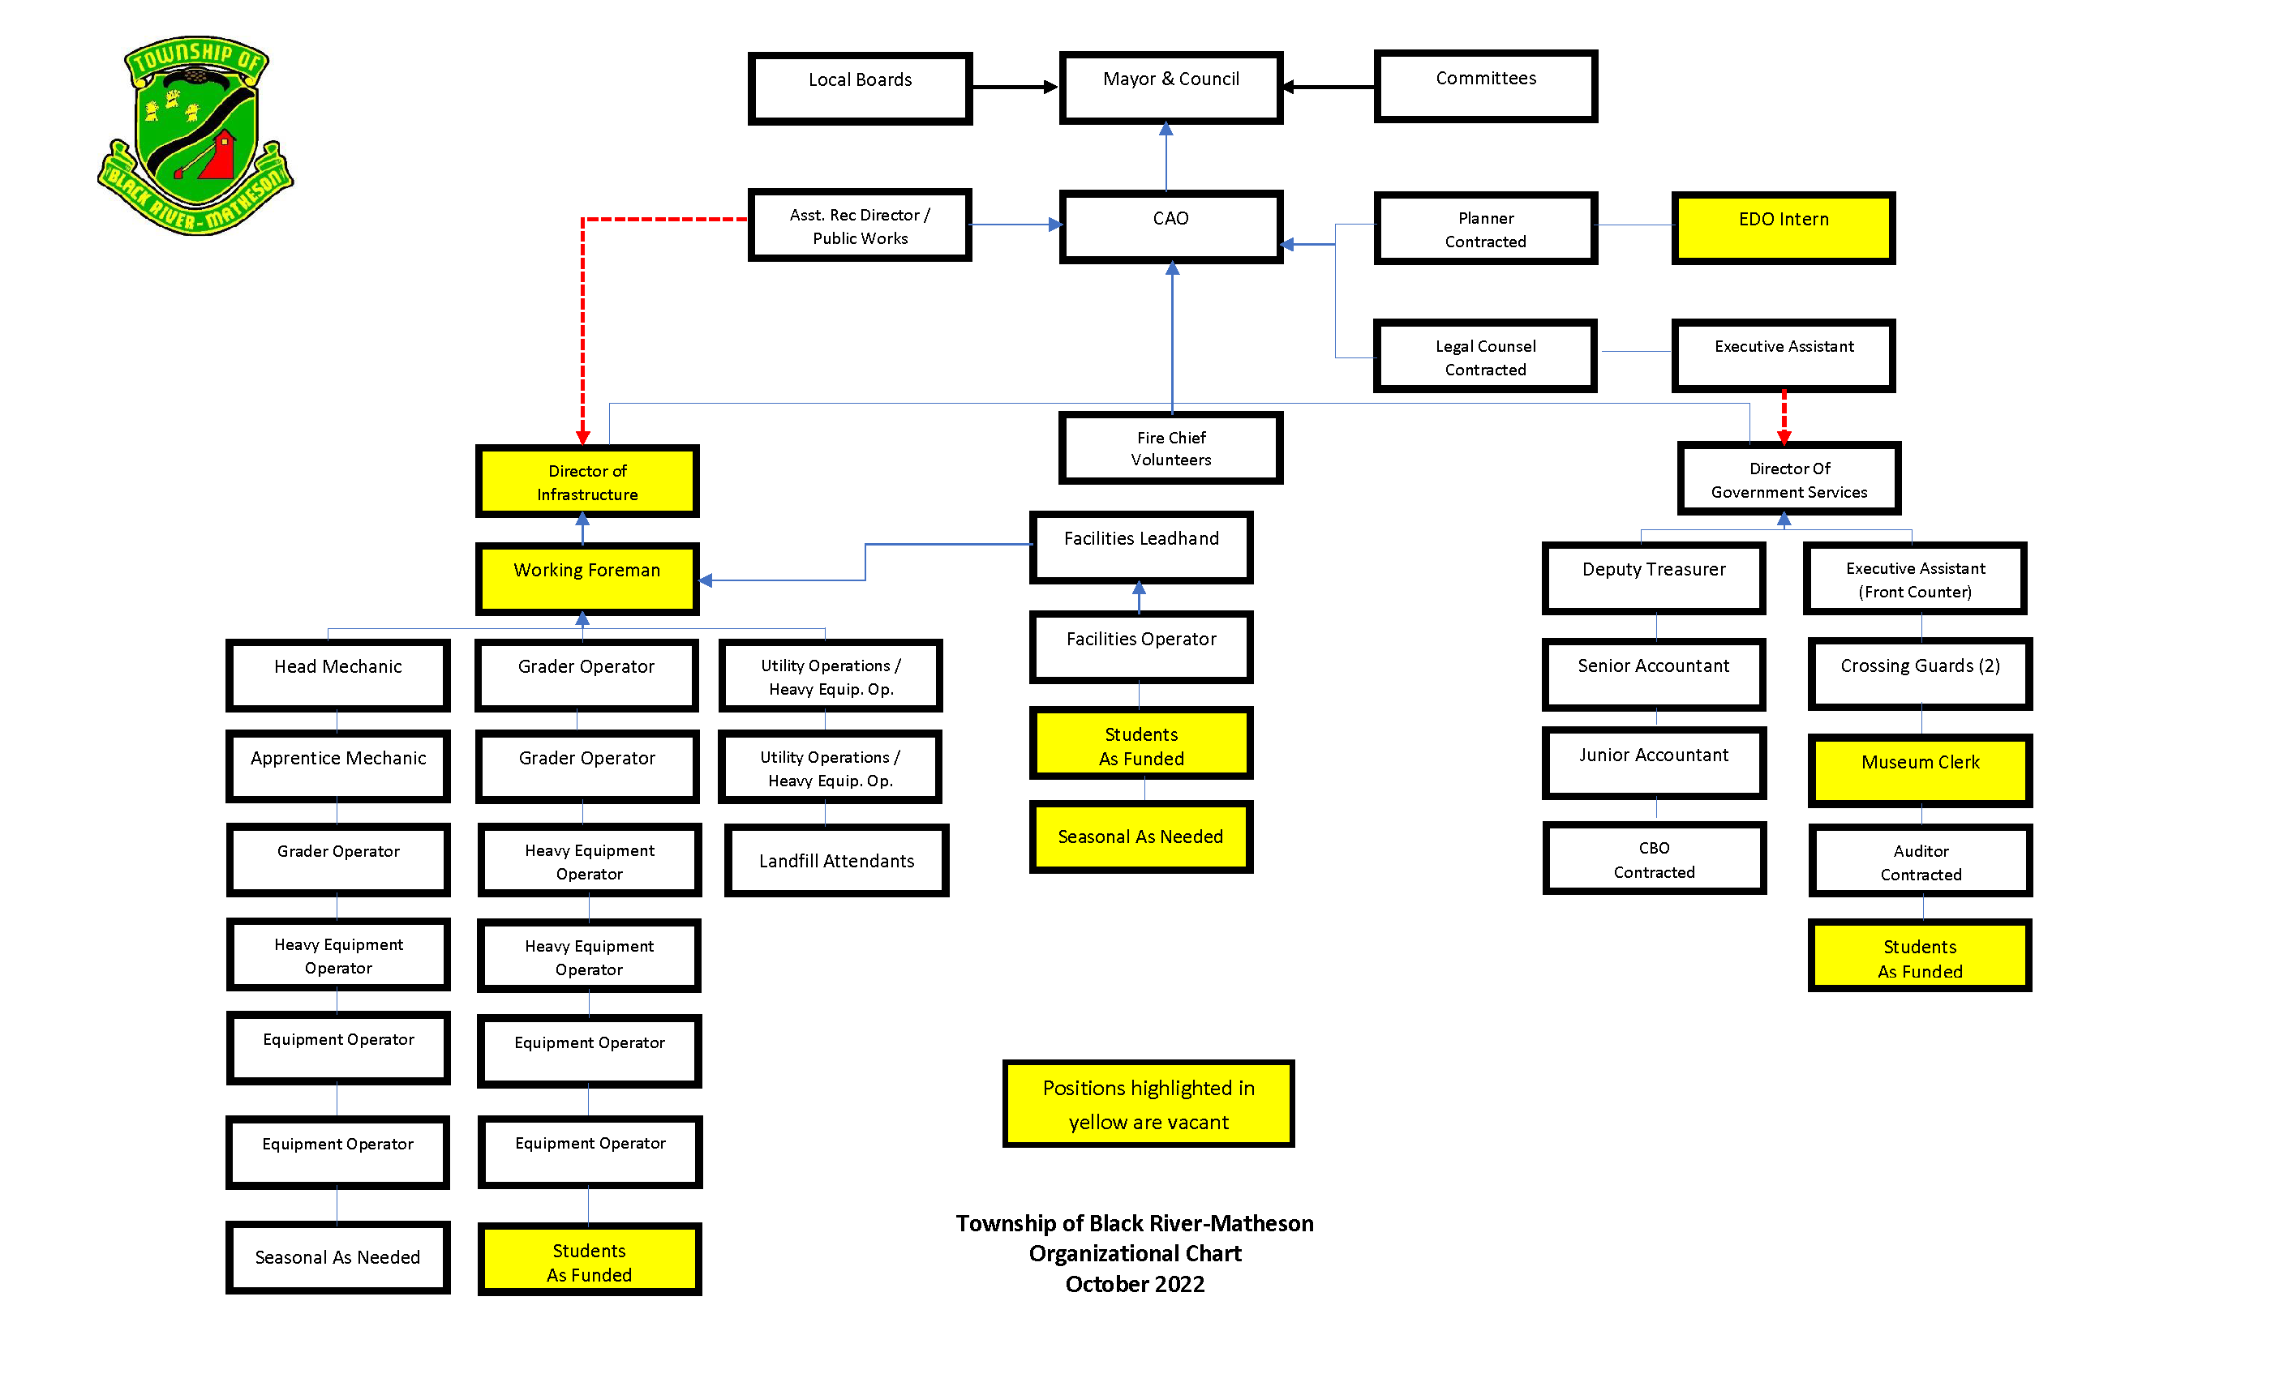

Slide 3
Municipal Departments
Chief Administrative Officer
Recreation
Public Works
Administration
Fire
Library

Slide 4

Library services
Library Services
Ipads
Puzzles
Cricket
Laminator
Toys
OSMO
Kano
Little Bit
Scrapbooking
Services with Fees
Sensory Room
Other Services
Printing
Photocopying
Fax
Laminating
Administrative Services
Basement for Rent
Books for Sale
E-books
Free Wi-fi
Interlibrary Loans
Locations
Matheson Library
Ramore Library

Slide 5
Library services
Fun Facts
A public library shall be under the management and control of a board
Council will hold a seat on the board
The board or librarian presents a budget for Council to consider funding

Slide 6
Office of the CAO
Economic Development
Human Resources
Land Use Planning
Risk Management & Insurance
Legal
Health & Safety
Grant Applications
Strategic Planning
GIS Mapping System
Overall Management
By-Law Enforcement
Information Technology
Financial Oversight
Grievances
Union Negotiations
Emergency Management
Visioning
Community Safety & Well Being
Council
Oversee Implementations of Council Decisions
Council/Staff Liaison
Principal Advisor to Council
Overall
Policy Development & Management

Slide 7
Office of the CAO
Highlights
Year | Grant Description | Grant Amount
2021 | Plans for new building, corrections and expansion | $100,000
 | Seniors Need Study | $60,000
 | Municipal Asset Management | $50,000
 | Internship Medial Recruiter | $31,500
 | Modernization Fund Intake 2-H&S-Risk | $23,963
 | Modernization Fund Intake 3- Digitization | $58,256
 | Internship for Ed. Dev. | $31,500
TOTAL |  | $355,219
Year | Grant Description | Grant Amount
2022 | Highway 11 Corridor | $675,000
 | Arena Refurbishment | $888,768
 | Park Lane Park | $75,000
TOTAL |  | $1,638,768

Slide 8
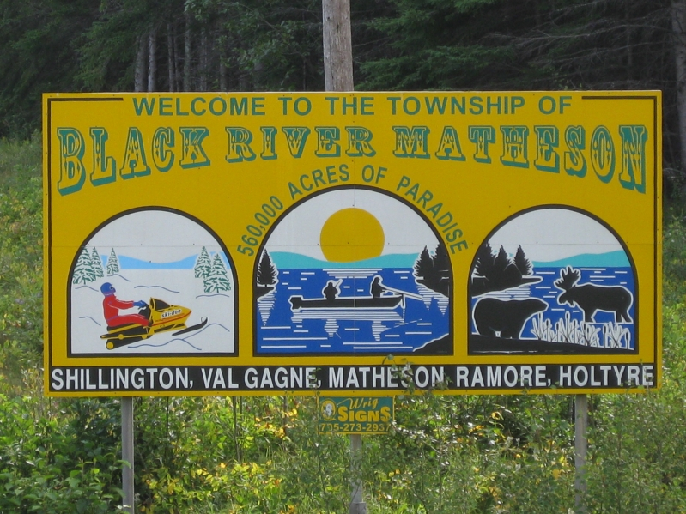

Recreation department
Arena
Museum
Cemeteries
Eight Cemeteries
Parks & Public Spaces
Other
Community Transportation Program
Four Parks to Maintain
Community Receptacle Pickup
Gym
Upstairs Hall
Canteen
Three Outdoor rinks & shacks
Boat Launch
Gauthier Lake
Hough Lake

Slide 9

Recreation department
Work To Do:
Develop Programs for All Ages
Increase Utilization of Arena
Decide the Future of the Outdoor Rinks
How to Further Utilize the Boat Launch
Development of Recreation Master Plan

Slide 10

Public Works department
Roadways
Facility Maintenance
Sidewalks
Boulevards
Engineering
Landfills
Municipal Drains & Drainage
Water
Waste Collection
Winter Maintenance
Ditching
Signage
Recycling
Sewer
Four Water Stations
One Sewage Plant
Three Lagoons
Capital Works
Infrastructure Projects

Slide 11

Public Works department
Plan/Focus:
Ditching
Road Resurfacing
Brushing
Replacement of Signs/Traffic Signs
Maintenance Plan
Road Study

Slide 12
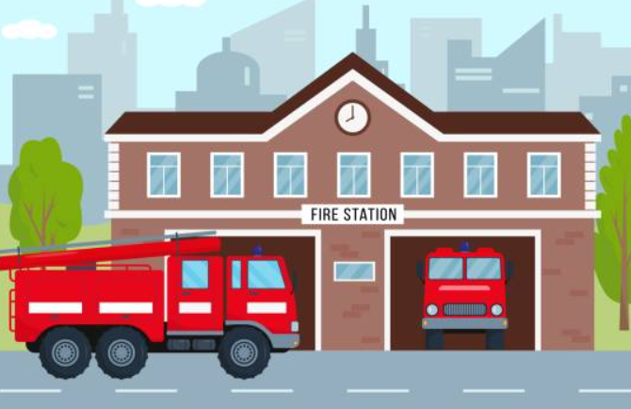
Fire department
Matheson
25
Fire Stations
Overall Compliment Requirement is 50
Val Gagne 10
Ramore
15
Current Compliment Overall is 35

Slide 13

Fire department
Main Responsibilities
All Fires
Interior Attack
Includes Search and Rescue
Exterior Attack
Wildland Fires
Auto Extrication
Hazmat Awareness
Shoreline Rescue
Other Responsibilities
Community Events
Fire Prevention/Education
Home Inspections:
Child & Family Services
DSSAB
Vulnerable Occupancy Fire Drill & Inspection
Public Education
Schools
Senior Buildings
Home Inspections
Food Drives
Boot Drives
Fireworks
Challenges
Large Geographical Footprint
Large Portion in Rural Areas
No hydrants
Water shuttling
Extreme Weather Conditions
Recruitment & Retention
Training
Compliance to Regulations
One Pumper Truck Out of Commission
PTSD

Slide 14

administration department
Clerk
Council & Committees Agendas, Minutes & Records
Records Retention
Freedom of Information Requests (FOI)
Municipal Elections
Legislative Reporting
Licensing
Treasury
Administration
Operating and Capital Budget
Taxation & Tax Registration
Financial Reporting
Audit
Asset Management
Utility Billing
User Fee Management
Payroll & Benefits
Account Payable
Purchasing
Investments
Cemeteries
Building Services
Museum
Crossing Guards
Investments

Slide 15

administration department
Outstanding Issues
Adjust operating revenues to operating expenses (o/s since 2019)
Rebuild Reserves to support 5 year capital plans
Adopt and follow Asset Management Plan as per O.Reg 588/17
Decide the future of the Thelma Miles Museum
Decide the future of the Old Municipal Building
Adopt new procurement by-law
Adopt new procedural by-law
Records Management

Slide 16
Municipal Master plan
“The plan is an organizational management activity that has been used to set priorities, focus energy and resources, strengthen operations ensure that employee and other stakeholders are working toward common goals, establish agreement around intended outcomes/results and assess and adjust the organization’s direction in response to a changing environment.”
Comprehensive Master Plan pg. 9

Slide 17
Municipal Master plan
The Master Plan is structured in two distinct ways:
Ongoing Council Actions
Thematic Key Directions
Strategic Leadership & Communication
Service Enhancement & Continuous Development
Employee Engagement Development
Renew Key Infrastructure & Services
Operational Excellence

Slide 18
Municipal Master plan 2023
Leadership & Communication
Action | Budget Consideration | Lead
Establish a plan for Open Government / Open Data | Yes | CAO
Change the name from Township to Municipality | Yes One-Time Cost | Council
Develop new branding for the Township and a set of corporate images and an associated policy for use | Yes One-Time Cost | CAO
Integrate the Museum with School Programs | No | Council
Service Enhancement & Continuous Improvement
Action | Budget Consideration | Lead
Trails Development Plan | Yes | Public Works
Establish a computerized purchase order and inventory system | Yes | Clerk-Treasurer

Slide 19
Municipal Master plan 2023-Cont’d
Employee Engagement & Development
Action | Budget Consideration | Lead
Develop a permanent program for the education of staff and Council on their respective roles. Any Council program should be part of each new Council Orientation. | NO | CAO
Hire a negotiating professional for the 2023 negotiations with CUPE 1490 | Yes | Council Completed
Renewal of Key Infrastructure & Services
Action | Budget Consideration | Lead
Shave and pave roads in Val Gagne and Ramore. | Yes | Public Works
Develop a parks master plan that includes the management of new trees. | Yes | Public Works

Slide 20
Municipal Master plan 2023-Cont’d
Operational Excellence
Action | Budget Consideration | Lead
Implement Customer Service Standard | No | CAO
Make changes to corporate systems as identified in the mapping process from the Organizational Study. | No | Clerk-Treasurer

Slide 21
Municipal Master plan 2024-2027 Parking Lot
2024-2027 Plan Parking Lot Subject to Approval of the 2023 to 2026 Council
Action | Budget Consideration | Lead
Have better signage, schedule of hours, curator training for the museum. | Yes | Council
Busing for Seniors and Swimming Lessons | Yes | Recreation
Waterfront Splash Park | Yes | Recreation
Develop Public Benches | Yes | Recreation
Establish a Recreation Hall in Holtyre | Yes | Recreation
Establish a Tennis Court by the Arena | Yes | Recreation
Move museum to existing building | Yes | Council

Slide 22
When you are in local government, you are on the ground, and you are looking into the eyes and hearts of the people you are there to serve. It teaches you to listen; it teaches you to be expansive in the people with whom you talk to, and I think that that engagement gives you political judgment.
-Valerie Jarrett

